Slide 2
Manthar Ali
Vishaka
Dua
Abhishek
Vishaka
Consolers

Slide 3




Guess the word…..

Slide 4




Slide 5





Slide 6
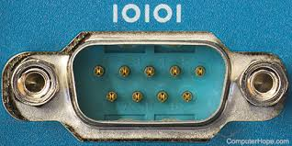

Ports
Serial Ports: These are connectors that allow data to be transmitted one bit at a time, over a single wire

Slide 7
Advantages
Longer Transmission Distance
Lower Manufacturing Costs
Less Susceptible to Interference

Slide 8

A parallel port is a type of connection that allows multiple bits of data to be sent at once, using several wires. This makes it faster than a serial port for short-distance communication

Slide 9
Advantage
Faster Data Transfer:
Easy Implementation:
Support for DMA:

Slide 10
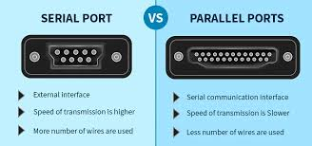

Slide 11
Causes for low performance in Pc:
1. Insufficient RAM (Memory)
2. Too Many Background Processes
3. Full Hard Drive
4. Malware or Bloatware
5. Overheating
6. Lack of System Updates

Slide 12
1. Manage Startup Programs(Ctrl-Shift-Esc.) Disabled the programs
2. Cleanup Disk Space: Deleting unnecessary and temporary files
3. Change Power Settings(Go to Settings>System>Power and Button)
4. Browser Extensions

Slide 13
8. Increase RAM
Check Viruses and Malware
Go to Privacy and Security>Windows Security. Then click on the Virus and Protection. Here, you will see scan options, click on it to see types of scan to run. Click on Full scan and then run it on your system to check for viruses.

Slide 14
How to increase the performance of processors
Upgrade Your CPU Cooler: Consider replacing your stock cooler with a better
aftermarket air or liquid cooling system.
Improve Case Airflow: Ensure your case has good airflow by adding more fans or
improving their placement.
Keep Your PC Clean: Dust buildup on fans and heatsinks can block airflow, causing overheating.

Slide 15
Continue
Keep your software and drivers updated
Close programs running in the background that you don’t need.
Use lighter software that uses fewer resources.

Slide 16

How to avoid the heat up procesor/pc?

Slide 17
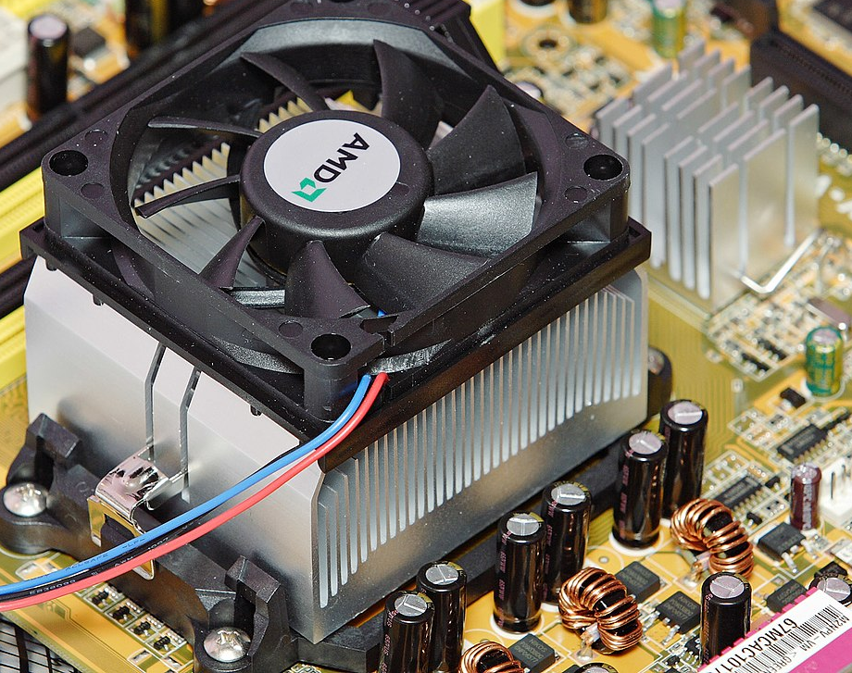
Heat Sink: Attach a quality heat sink to your CPU to absorb and dissipate heat.

Slide 18
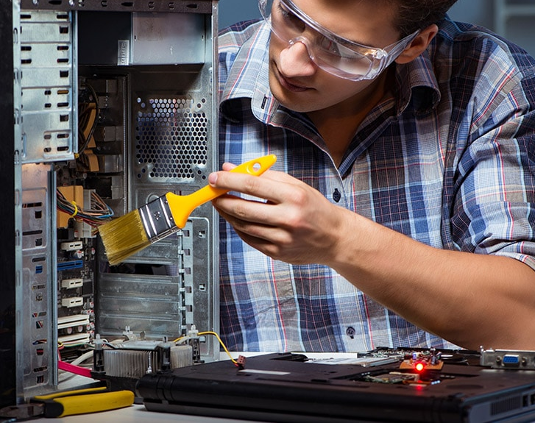
Regular Cleaning

Slide 19

Room Temperature:

